Slide 1



Indian premier league
Cricket T20 tournament

Slide 2
Introduction:
The Indian premier league(ipl) is men’s T20 l cricket league that is held in india there teams represent cities in india Fans get see some of the best cricket player in world.
OBJECTIVE :
To advance cricket in india and foster the development of new gifted players .
To analyze player performance and develop strategies to improve it.
To raise the standerds of domestic cricket and give domestic players fair opportunities.
As it contribute more than $300 million to the GDP or the nation.

Slide 3
ER Diagram:
Team_id
name
Has
team
Match_id
Team_id
owner
coach
match
Result
Belonge
to
Player_id
Run
won
Loss
Name
Player match state
Roll
Wicket
player
stadium
Player_id
Team_id
Match_id
Name
Name
Roll
city
Stadium_id

Slide 4
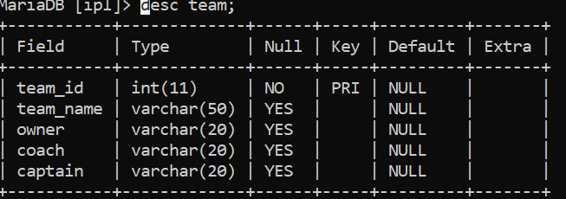
STRUCTURE OF TABLES
TEAM:
The team table contain the detail of all teams are participating in the ipl tournament. Team there owners, coach and captains and detail.

Slide 5
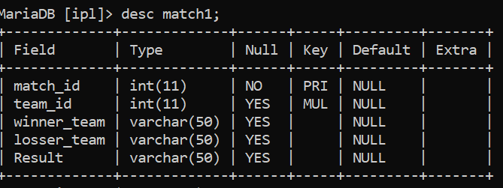
MATCH:
It details contains the matches have to play and there results .

Slide 6
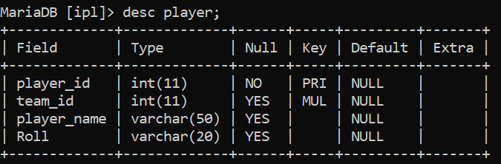
PLAYER:
The table contain players detail which is player name there roll .

Slide 7
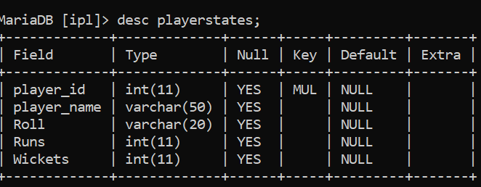
PLAYERSTATES:
The tables contain player detail there history is score have to be score in the tournament.

Slide 8
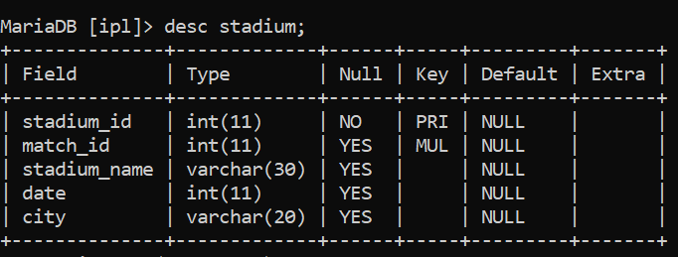
STADIUM:
Is the table contains the name of the stadium played the match .

Slide 9
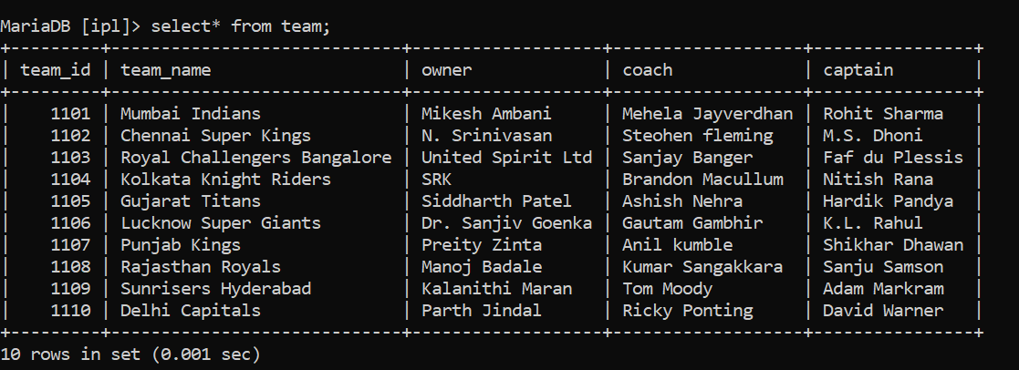
CONTENTS OF TABLES
TEAM:

Slide 10
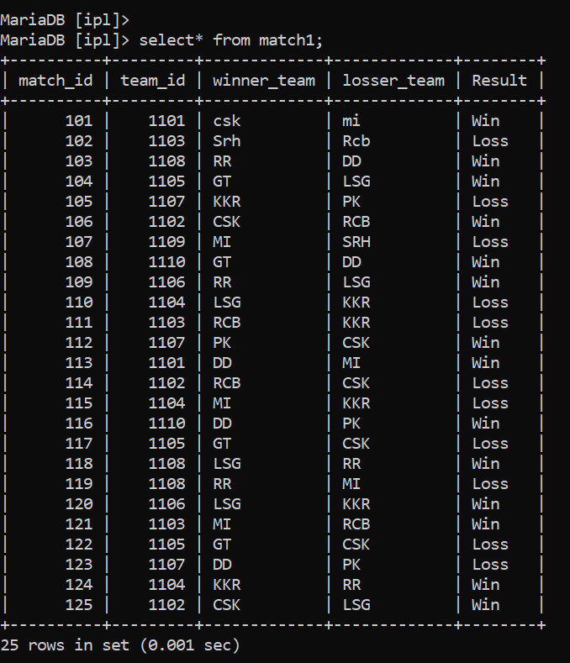
MATCH:

Slide 11
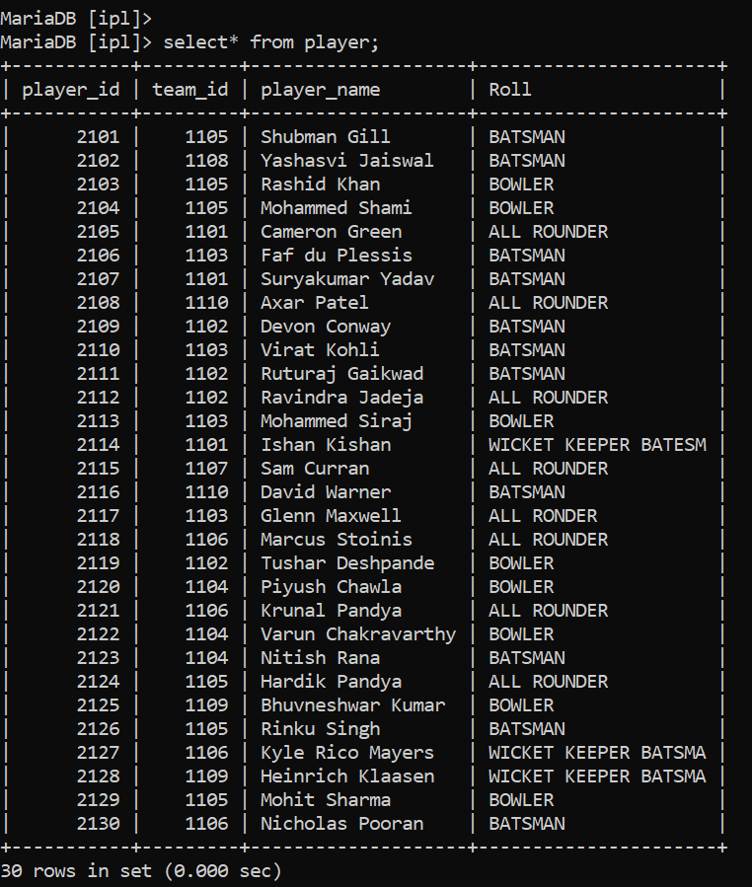
PLAYER:

Slide 12
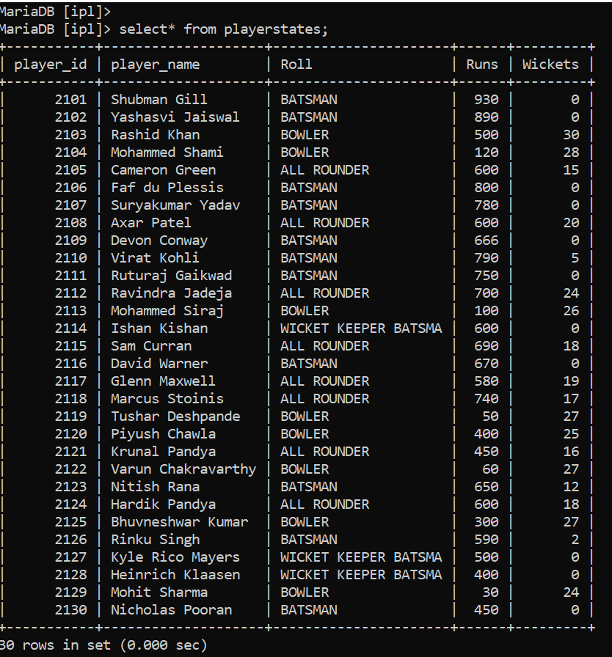
PLAYERSTATES:

Slide 13
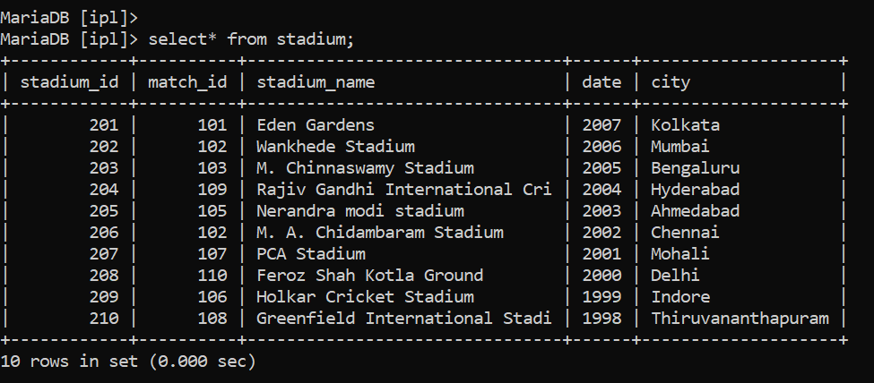
STADIUM:

Slide 14
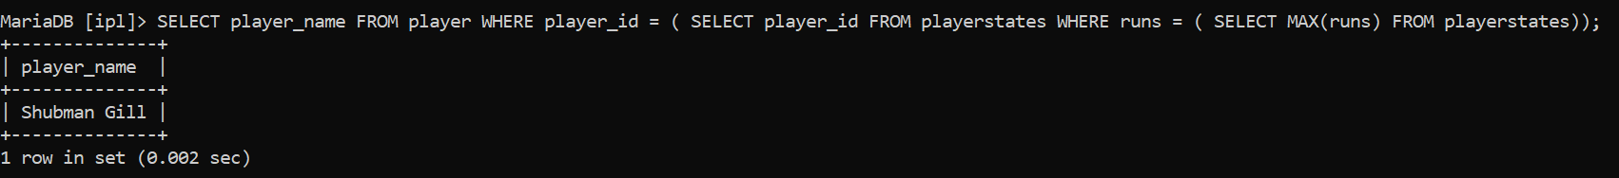
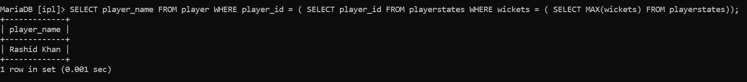
SUBQURIES
1. Display a player name who has scored most run in the ipl.
2. Display a player name who has most wicket in the ipl

Slide 15
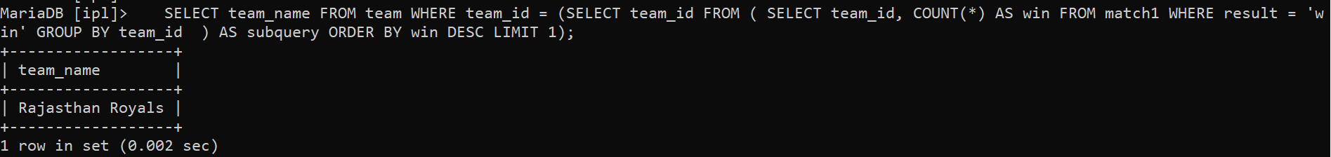
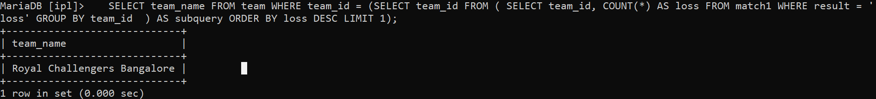
3.Display the most win matches in the tournemnt
4.Display the most lose mtches in the tournemnt.

